Slide 1
Cloud Removal from Satellite Images
Objective
To eliminate small-scale distortions caused by clouds or precipitation from Temporal composite surface brightness Images, which are generated from special sensor microwave/Imager (SSM/I).

Slide 2
Cloud Removal from Satellite Images
Introduction
Problems faced while using Microwave radiometers for atmospheric and oceanic studies :
    Disturbances caused by the presence of clouds are the greatest source of error in remote sensing of earth terrains.
    Clouds obscure the terrain – image processing algorithms designed for analysis of terrains are very sensitive to such disturbances.
Mean, second highest value, modified maximum average (MMA), and hybrid composition algorithms are the few algorithms which can be used for removal of clouds.
MMA provides a more accurate brightness temperature estimate in areas of atmospheric distortion, while the mean is superior in regions with little or no distortion.
A hybrid algorithm is developed that is a combination of MMA and mean. It utilizes the strengths of both to create a superior algorithm for regions with varying levels of distortion.

Slide 3
Cloud Removal from Satellite Images
Algorithm – Cloud Detection
While traversing through the image, on a particular pixel we select a mask of the given mask size. On this mask we find the variance and saturation of all the pixel values. The threshold values of variance and saturation are specified by user.
Variance: The variance tells us about the deviation of the gray values of the clouds. Low variance means that the clouds are similar and high values gives us an indication that the clouds are varying within a given mask.
    When the mask variance is greater than the given variance threshold then the probability of the mask being a cloud is very less as generally there is not much deviation in a cloud.
    Otherwise, there is high probability that the mask is a cloud since in case of clouds the variance of gray values of the pixels (of cloud) is quite low.
Saturation: Lower saturation value means pixel value more close to white color. On setting the value of saturation threshold low, we are detecting only those clouds which are very close to white color.
    Lower saturation threshold will detect clouds closer to white and higher threshold value will detect darker clouds.
We start with an image. Traverse the mask across the image. While doing this we keep on marking the point as either cloud (white color) or non-clouds (black color). After the mask has traveled the whole image, we finally get a gray image depicting clouds.

Slide 4
Cloud Removal from Satellite Images
Algorithm – Cloud Removal
The presence of clouds increases the intensity of the original image. So for the removal of cloud we need to decrease the intensity of that pixel. For this we use the equation.
Icloud = 1/3(R+G+B)
Put the values of R, G, B to get the intensity of the cloud. Decrease this intensity from the original image intensity to get the intensity of the desired image.
Idesired = Iimage – Icloud
The presence of cloud decrease the saturation value of a particular pixel. We need to find the saturation value of the cloud and add this value to the saturation value of the given image.
Sdesired = Simage – Scloud
We don’t have any idea about the scene hidden behind the cloud we cannot calculate the exact value of saturation value of the cloud. Here we have taken the approximation that Scloud can be calculated as follows.
    Scloud = k X Y[I,j]
Note: Here we have taken only one of the RGB component to calculate the values of Icloud and Scloud. This is just to differentiate the original image and the desired image.

Slide 5
Cloud Removal from Satellite Images
Results
We have tried to process several images and realized that this algorithm works best when the clouds are of low density. If the clouds are of very high density then it is too difficult for the algorithm to determine the pattern behind them. On cloud removal also the code generates satisfactory results.
As the algorithm detects the presence of cloud in an image we can apply the MMA , mean or second highest or hybrid algorithm depending upon the intensity of cloud at that region.

Slide 6
Cloud Removal from Satellite Images
Graphical User Interface

Slide 7
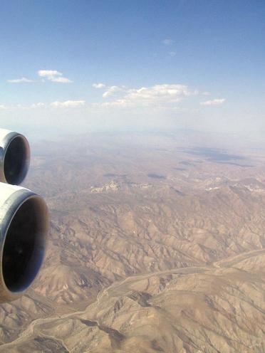
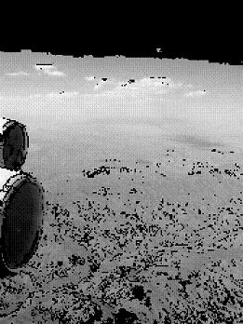
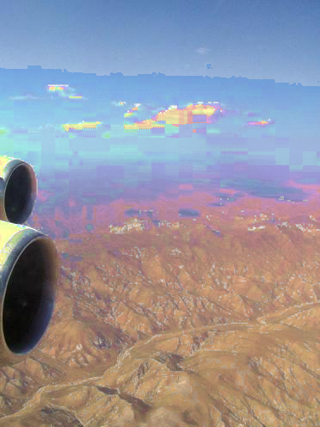
Cloud Removal from Satellite Images
Sample Example - Output
Original Image
Detected Clouds
Approx resulting Image

Slide 8
Cloud Removal from Satellite Images
Applications
Major application in remote sensing – can be used as a pre-processing step before analyzing satellite images.
Modern satellite images of terrains are used as textures for rendering artificial terrains – images must be disturbance free.
References
“A Cloud-Removal Algorithm for SSM/I Data”
by David G. Long, Senior Member, IEEE, Quinn P. Remund, and Douglas L. Daum
WWW.IEEEXPLORE.COM
- IEEE Transactions on Geosciences and Remote Sensing

